Slide 1
Fix your SQL database design with T-SQL code analysis and Copilot
@ErikEJ

Slide 2
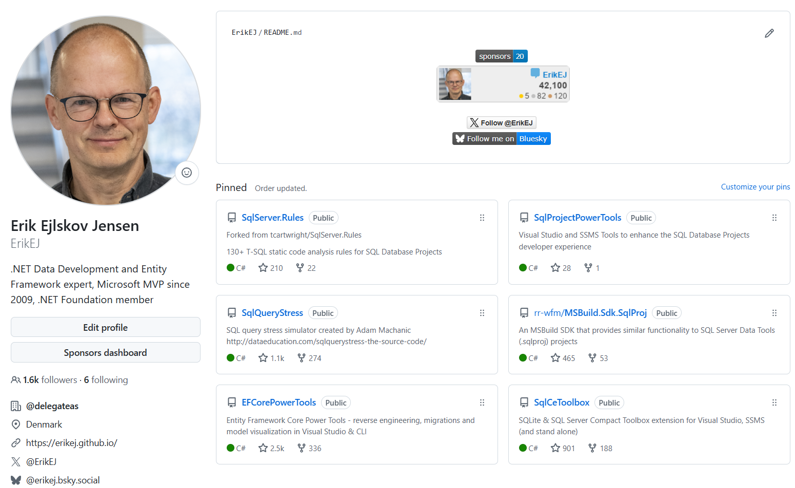

Slide 3


Slide 4
Challenges?
Runtime errors in database due to uncaught syntax errors
No standard approach to naming or other database design ”business rules”
No qualified review of schema design
Feedback on schema design issues late in the process
No cross platform build and deployment support
No proper NuGet integration (.dacpac files, rules)

Slide 5
Process
Create / import .sql scripts
Build & Analyze
.dacpac
Deploy
Create SQL project
DacFX

Slide 6
Demo - SSMS 22

Slide 7
Static code analysis in SSMS
Use a SQL Project for highest fidelity and CI/CD capabilities
Use rule manager and docs to decide on rules to use
Customize or even create / contribute your own rules

Slide 8
Demo - CLI

Slide 9
tsqlanalyze CLI recap
Use when no SQL Projects in use
Also to analyze existing database or .dacpac
Enable the local MCP Server to provide code fixes

Slide 10
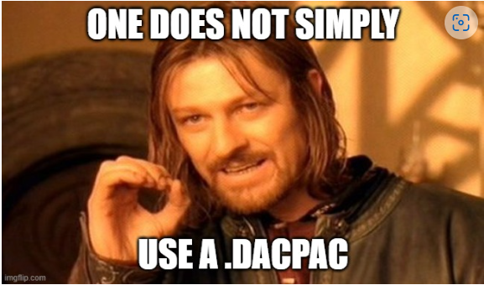
Q & A

Slide 11
Q & A
I use Postgres / Oracle /MySQL – can I use this?
Does it work on Azure SQL Databases?
Can I create my own rules?

Slide 12

CTA
Add you database schema to source control
Enable code analysis locally and in CI
Optional: Create your own rules and contribute them back to the community
FEEDBACK via App

Slide 13
Q & A
Sharing parts of a database (f.ex. monitoring) ?
What if my db has dependencies on other database?
How would this work with EF Core?
How about .NET Aspire?

Slide 14
Classic .sqlproj vs MSBuild.SDK.SqlProj
 | .SQLPROJ (Legacy VS) | MSBuild.SDK.SqlProj
Create, build, publish a .dacpac | ✔ | ✔
Run Code Analysis | ✔ 15 rules | ✔ 140+ rules
Run custom rules | ✔ admin only | ✔
Run rules on hosted agent | ✔ | ✔
Run custom rules on hosted agent | ❌ | ✔
Build on Linux (dotnet build) | ❌ | ✔
Visual designers/Schema compare | ✔ | ❌
NuGet pack (.dacpac/rules) | ❌ | ✔
SQL CLR | ✔ | ❌ (workaround)

Slide 15
What is a dacpac and why should I care?

Slide 16
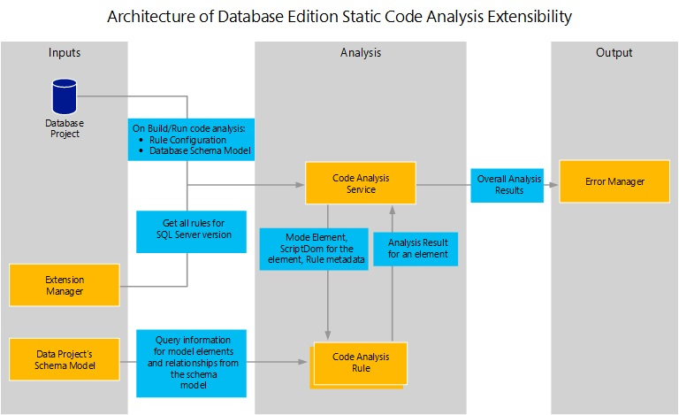

Slide 17
Why?
Data Tier Application Package
Get your database under source control
Ensure your .sql scripts ”build” – code validation
Ensure your .sql scripts follow business rules – code analysis
Deploy changes to the database schema with changes to your app
No more migration scripts – simply describe your desired state
Cross platform build and deployment support

Slide 18

Process
Create .sql scripts
Build
.dacpac
Deploy
Create .sqlproj

Slide 19
Tooling
Create / import .sql scripts
Build & Analyze
.dacpac
Deploy
Create SQL project
Visual Studio
VS Code
sqlpackage extract
dotnet new
Azure DevOps pipelines
GitHub actions
sqlpackage publish
MSBuild
dotnet build
dotnet pack Analyzer rules
DacFX

Slide 20

Why .dacpac?
Ensure high quality and consistent SQL schema under source control
Enforce design, performance and security rules
Desired state configuration
Publish magic!

